Slide 1

Mango Fruit Detection from Aerial Image
Marawan Ashraf Eldeib
1181102334
Computer Engineering (CE)
Supervisor : Mohd Haris Lye Abdullah
Moderator : Hezerul Abdel Karim
Trimester 2, 2023/2024

Slide 2
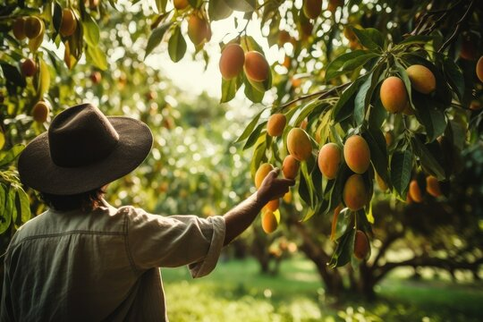
Introduction
In agriculture, mango cultivation has traditionally relied on manual labor for tasks like fruit counting and yield estimation. However, technological advancements, including aerial imaging and AI, are now revolutionizing this practice. Drones equipped with high-resolution cameras fly over mango orchards, collecting data that, when processed using cutting-edge machine learning, promises to make mango harvesting more efficient and precise.

Slide 3
Objectives
Evaluate public dataset on mango fruit detection. Collect and label mango fruit detection dataset from aerial images collected with a drone.
Design and train object detection model aimed at detecting mango fruits from aerial images.
Evaluate the performance of the model based on the prepared dataset.

Slide 4
Literature Review
“Deep Fruit Detection in Orchards”
“Visual detection of green mangoes by an unmanned aerial vehicle in orchards based on a deep learning method”
“Detection and Localisation of Farm Mangoes using YOLOv5 Deep Learning Technique”
“Real Time Riped Fruit Detection using Faster R-CNN Deep Neural Network Models” Literature Review
“Real Time Riped Fruit Detection using Faster R-CNN Deep Neural Network Models” Literature Review

Slide 5
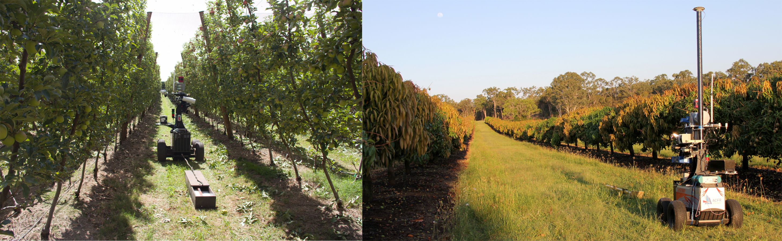
“Deep Fruit Detection in Orchards” Literature Review
Objective: Developing an advanced fruit detection system for yield mapping and robotic harvesting.
Methodology: Used Faster R-CNN with ZF and VGG16 architectures for detecting fruits like mangoes and apples.
Data Augmentation: Reduced the need for large training datasets.
Transfer Learning: Minimal gains observed when transferring knowledge across orchards.
Notes:
Paper [4] presents the research on developing a precise and reliable fruit detection system for advanced agricultural tasks, such as yield mapping and robotic harvesting, which is critical for modern orchard management. The method used is the Faster R-CNN object detection framework, which was tested with different network architectures including ZF and VGG16 to identify fruits like mangoes, almonds, and apples. The research implemented data augmentation techniques that enhance the model's ability to generalize by transforming the training data while preserving labels, significantly reducing the amount of training data needed. Additionally, Transfer learning was also evaluated but showed minimal performance gains when transferring knowledge from orchard to orchard compared to training from scratch with ImageNet features.

Slide 6
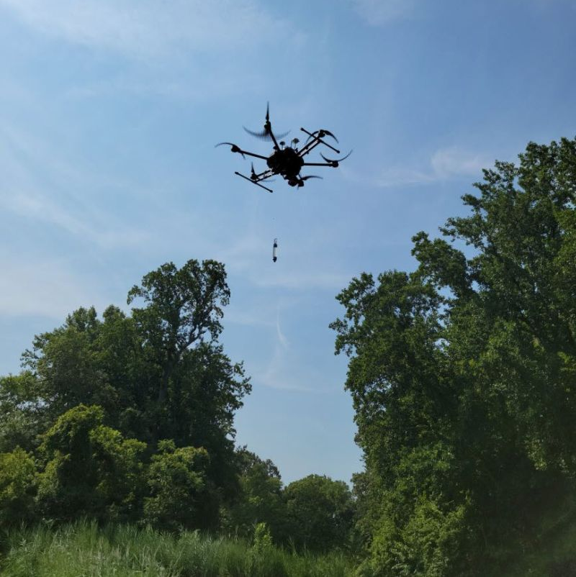
“Deep Fruit Detection in Orchards” Literature Review
Results: High F1-scores over 0.9 for apples and mangoes, indicating accurate detection.
Limitation: Ground-based vehicle used for image capture limits coverage.
Potential Solution: Using drones for better orchard imaging and detection accuracy.

Slide 7
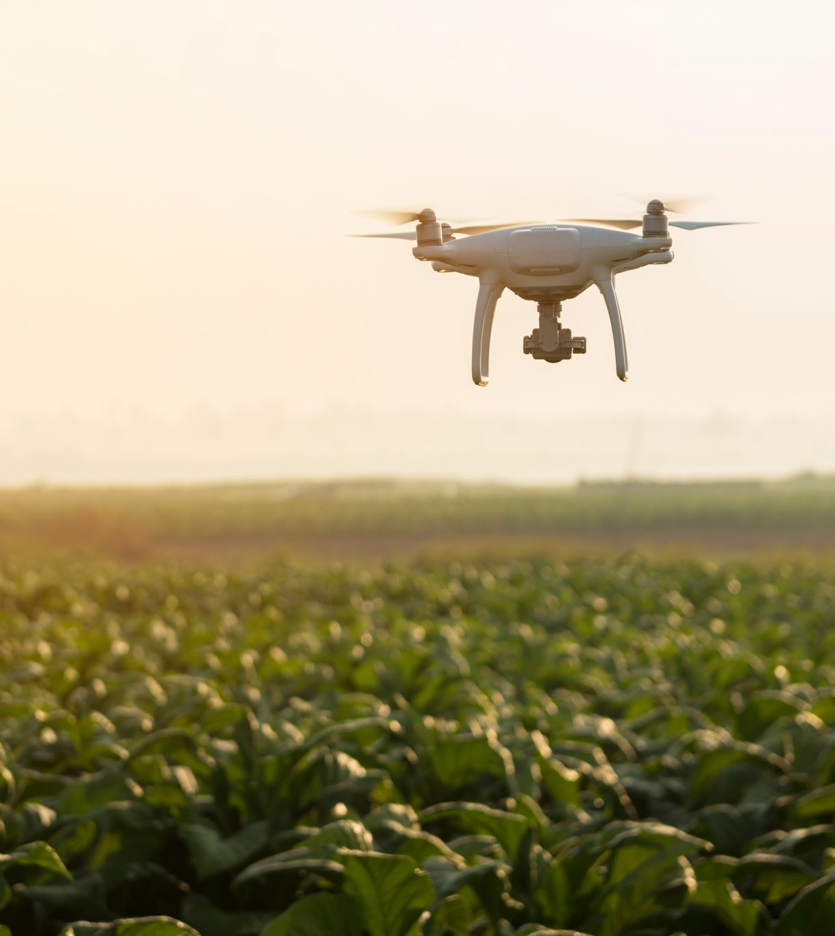
“Visual detection of green mangoes by an unmanned aerial vehicle in orchards based on a deep learning method” Literature Review.
Objective: Develop a method for detecting green mangoes in orchards using UAVs.
Methodology: Employed YOLOv2 model for rapid detection capabilities, with UAV-captured mango images that were manually annotated for training and testing. Fine-tuned YOLOv2 parameters.
Results: Achieved 86.4% mAP on training set; precision of 96.1% and recall of 89.0% in real-world conditions.
Limitation: Reliance on the earlier YOLOv2 model.
Potential Solution: Potential use of advanced YOLO models for enhanced accuracy and robustness in fruit detection.
Notes:
Paper [5] explores the development of a method for visually detecting green mangoes in orchards using unmanned aerial vehicles (UAVs), a crucial step for efficient orchard management. The method employed was the YOLOv2 (You Only Look Once, version 2) deep learning model for its rapid detection capabilities. The methodology involved capturing mango images through UAVs, followed by manual annotation to create precise training and test datasets, which were then used to fine-tune the YOLOv2 model's parameters. The results of the study were promising, showing effective learning and improved performance in mango detection as indicated by the dynamics of the network's loss value and the metrics of precision and recall calculated using a confusion matrix. Precision and recall are essential for evaluating the accuracy and thoroughness of the model's detection capabilities. However, the study's dependence on YOLOv2 was identified as a limitation, considering it is an earlier iteration of the YOLO technology and lacks subsequent advancements in object detection techniques. This suggests the potential for integrating more recent YOLO models to potentially enhance the accuracy and robustness of fruit detection systems in agricultural applications.

Slide 8
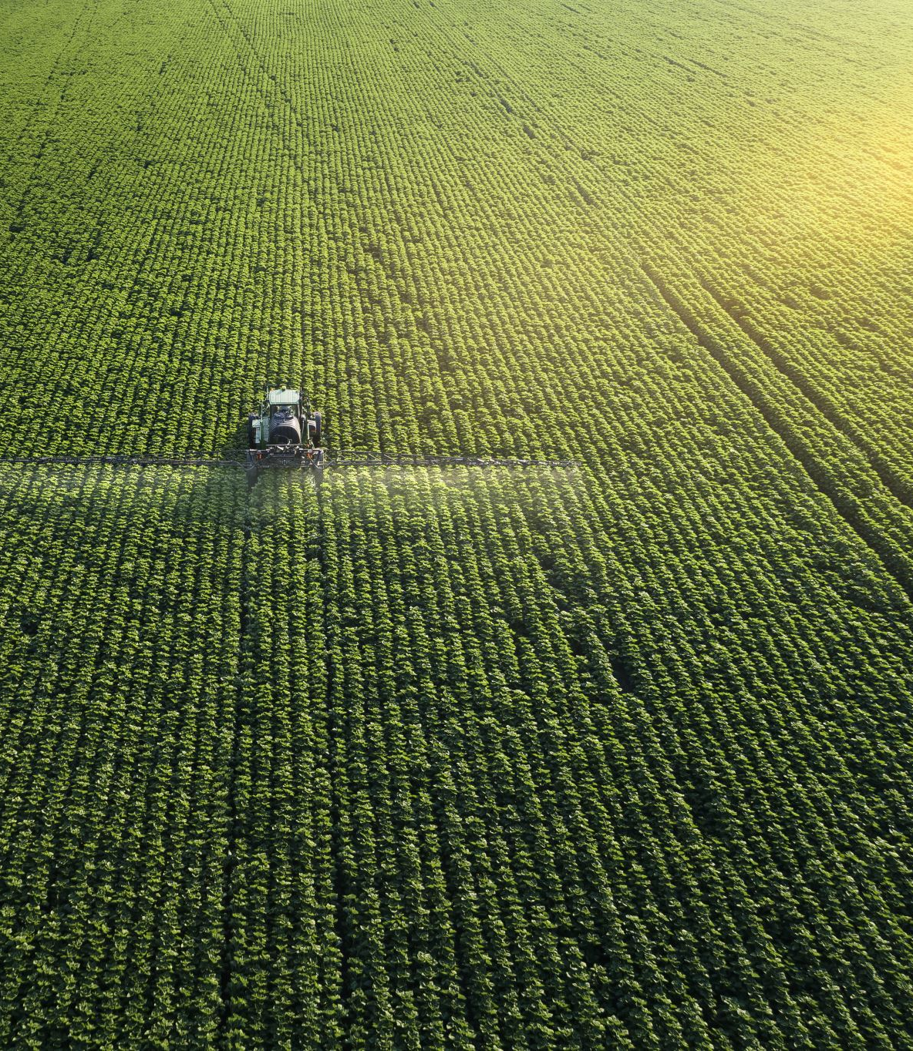
“Detection and Localisation of Farm Mangoes using YOLOv5 Deep Learning Technique” Literature Review
Objective: Improve mango detection and localization on farms using YOLOv5.
Methodology: Trained YOLOv5 on 150 mango farm images, using 20,000 training steps and a batch size of 64.
Results: Achieved mAP of 0.434, F1 score of 0.57. 94.3% accuracy on test images, 80.76% in real-time video.
Limitation: YOLOv5 may underperform in varied farm conditions.
Potential Solution: Upgrade to advanced YOLO models for enhanced fruit detection or integrate additional sensors for higher accuracy.
Notes:
Paper [6] presents a study on the detection and localization of farm mangoes using the YOLOv5 deep learning technique. This research focuses on addressing the complexities of mango fruit detection in real farm environments, like occlusion, shadow, and variable lighting, which is vital for yield monitoring and harvesting automation. The study utilizes YOLOv5 for its high inference speed and trains the model on a dataset of 150 mango fruit images from farms using parameters like 20,000 training steps, and batch size 64. Notably, the developed model detects and localizes farm mangoes with a mean average precision (mAP) of 0.434 and an F1 score of 0.57, demonstrating 94.3% accuracy from test images and the model proved its adequacy for the real-time detection of the farm mangoes using the recorded video with an average accuracy of 80.76%.

Slide 9
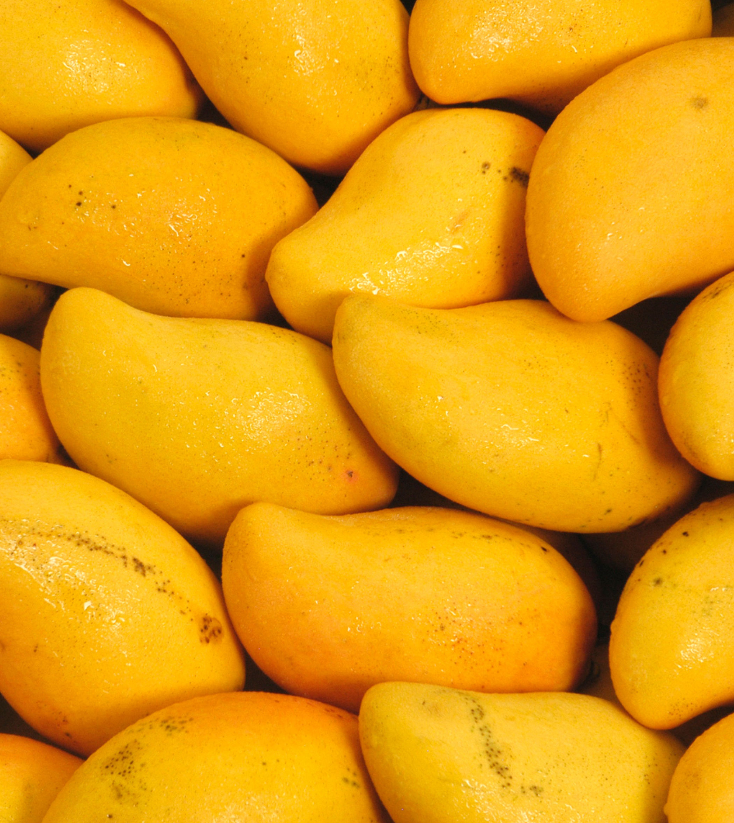
“Real Time Riped Fruit Detection using Faster R-CNN Deep Neural Network Models” Literature Review
Objective: Improve real-time ripe fruit detection in agriculture using advanced deep learning.
Methodology: Used Faster R-CNN with VGG16, ResNet50, and InceptionV2 architectures on Fruits-360 dataset, expanded via data augmentation.
Results: Achieved a mean average precision (mAP) of 0.869. InceptionV2 architecture demonstrated the highest accuracy.
Limitation: The two-stage detection process is computationally intensive, affecting real-time application.
Potential Solution: Investigate ways to make the model more efficient for real-time applications, balancing speed and accuracy.
Notes:
Paper [7] investigates ripe fruit detection using the Faster R-CNN model, integrating VGG16, ResNet50, and InceptionV2 architectures. The study used a Fruits-360 dataset, partitioned into training (60%), validation (20%), and test (20%) groups, focusing on 300 images with data augmentation. It achieved a mean average precision (mAP) of 0.869. Figure ‎3.5 shows in detail the performance of each architecture, with InceptionV2 as the most accurate.
The research highlights the trade-off between speed and accuracy in CNN architectures, noting Faster R-CNN's higher accuracy but greater computational demands. The main limitation lies in the computational complexity and slower processing speed of the two-stage Faster R-CNN approach, suggesting a need for improved efficiency in real-time agricultural scenarios.

Slide 10
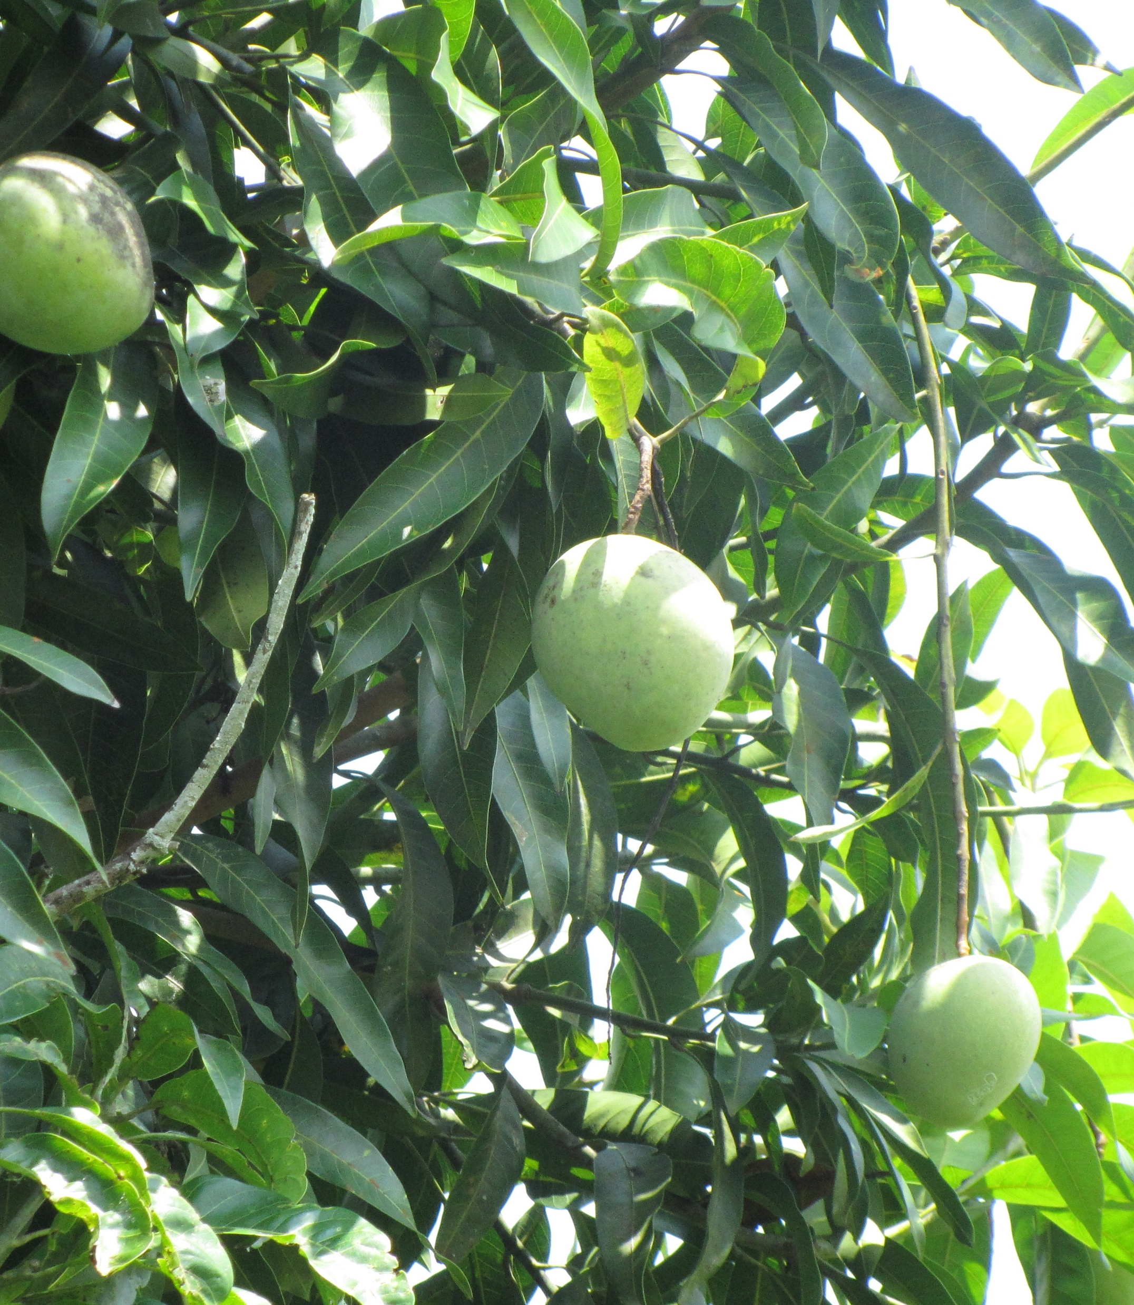
“Computer Vision System for Mango Fruit Defect Detection using Deep Convolutional Neural Network” Literature Review
Objective: Automate mango defect detection using a CNN-based vision system.
Methodology: Used 100 Kent mango images, augmented to 800; improved quality with histogram equalization and adaptive Wiener filtering. Trained the CNN with this data.
Results: Achieved 98.5% accuracy in defect detection
Limitation: Requires high computational power and the need for a large amount of data
Potential Solution: Explore efficient training methods or transfer learning to lower computational and data needs
Notes:
Paper [8] presents a study on automatic mango defect detection using a computer vision system and a Convolutional Neural Network (CNN). The research utilized 100 images of Kent mangoes, augmented to 800 images through data augmentation techniques. The CNN model was trained and tested on this dataset, with preprocessing steps like histogram equalization and adaptive Wiener filtering to enhance image quality. Histogram equalization enhances image contrast, while adaptive Wiener filtering reduces noise. The study achieved a classification accuracy of 98.5%, demonstrating the effectiveness of CNN in identifying defects in mangoes. However, a key limitation noted was the computational intensity of the training process and the need for a large amount of data to train the deep learning model effectively. A summary of the research conducted in the papers [4] – [8] reveals that, although all the studies use deep learning to detect fruit, they all look at various architectures and techniques. Papers [4] and [7] utilize Faster R-CNN, with variations in network architectures, and demonstrate high detection rates. Papers [5] and [6] focus on YOLO variations, with [5] using an earlier YOLOv2 version, and [6] advancing to YOLOv5, highlighting the evolution of YOLO technology for improved performance despite environmental challenges. Paper [8] employs a CNN for defect detection, achieving high accuracy but noting the need for extensive data. These articles highlight the trade-offs between computing demands, accuracy, and speed when taken as a whole. My work contributes to this body of research by proposing a model that aims to enhance detection accuracy using aerial imagery, which could address the limitations noted in ground-based image capture methods and potentially improve the robustness and efficiency of fruit detection in diverse orchard environments.

Slide 11
Methodology
Installation
Data Preparation
Data Annotation
Data augmentation
Training
Evaluation
Dataset splitting

Slide 12



Technologies Overview
GPU - CUDA: Speeds up general-purpose computing on GPUs.
Framework - PyTorch: Open-source, BSD-licensed framework for various ML tasks.
Roboflow: annotation and dataset preparation.

Slide 13
Libraries
Library | Purpose | Key Features
Torchvision | Computer vision package for PyTorch. | Pre-trained models, datasets, image transformations.
NumPy | Scientific computing in Python. | Multi-dimensional arrays, mathematical functions.
Pandas | Data analysis and manipulation. | Data structures for numerical tables.
PIL (Python Imaging Library) | A library for opening, manipulating, and saving many different image file formats. | Useful for image processing.
Matplotlib | A plotting library for creating static, interactive, and animated visualizations in Python. | Used for plotting training results and data visualization.
Notes:
Matplotlib is a plotting library for the Python programming language and its numerical mathematics extension NumPy. It provides an object-oriented API for embedding plots into applications using general-purpose GUI toolkits like Tkinter, wxPython, Qt, or GTK.a NumPy is a library for the Python programming language, adding support for large, multi-dimensional arrays and matrices, along with a large collection of high-level mathematical functions to operate on these arrays.
Pandas is a software library written for the Python programming language for data manipulation and analysis. In particular, it offers data structures and operations for manipulating numerical tables and time series The torch package contains data structures for multi-dimensional tensors and defines mathematical operations over these tensors. Additionally, it provides many utilities for efficient serialization of Tensors and arbitrary types, and other useful utilities.
It has a CUDA counterpart, that enables you to run your tensor computations on an NVIDIA GPU .
PIL, short for Python Imaging Library, is a powerful and widely-used library for image processing tasks in Python. It provides a range of features and functions that make it easy to manipulate and enhance images, and it's a popular choice for developers working on machine learning projects

Slide 14
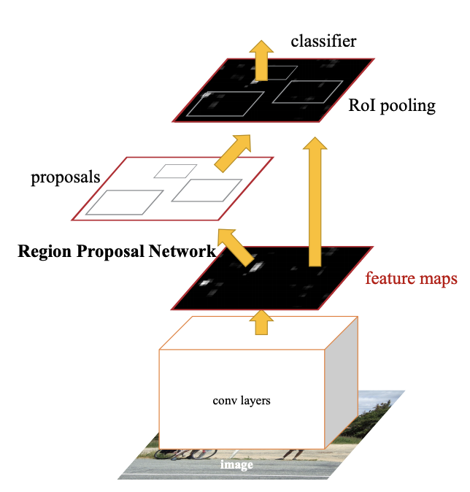
Faster R-CNN
Faster R-CNN (Faster Region-Convolutional Neural Network) is a powerful deep learning model introduced in 2015. It efficiently predicts object locations with high accuracy. Unlike traditional methods, it replaces the time-consuming selective search algorithm by allowing the network itself to learn region proposals.
Notes:
Faster R-CNN (Faster Region-Convolutional Neural Network) is a deep convolutional network that can quickly and accurately predict the locations of objects. It was introduced in 2015. Faster R-CNN is an object detection algorithm which eliminates the use of selective search algorithm(to find out the region proposals which is time consuming) and let the network learn the region proposals

Slide 15

VGG16 (Visual Geometry Group)
Consists of 16 layers
Simplicity of architecture: Easy to understand and modify
Slower training: Due to depth and parameter count
Common use: Feature extraction in computer vision applications

Slide 16

ResNet50(Residual Network)
Deeper network: Consists of 50 layers
Complex architecture: Incorporates residual blocks
Efficient training: Faster training due to residual connections
Versatility: Suitable for image classification and as a backbone for complex computer vision tasks
Notes:
VGG16 is a good choice for straightforward tasks and where model simplicity is key, whereas ResNet50 is more suitable for deeper and more complex tasks, offering higher performance and efficiency.
Tends to outperform VGG16 in terms of accuracy on many benchmarks.

Slide 17
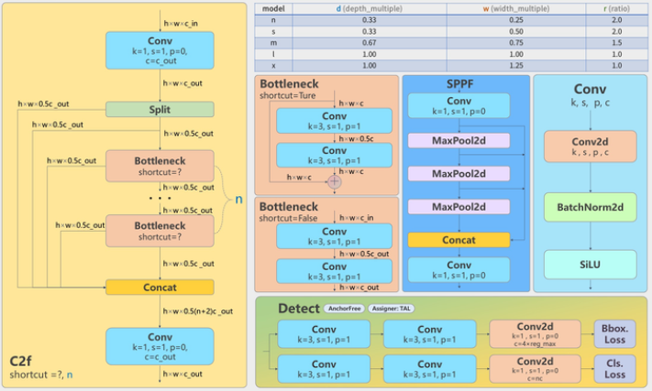
Yolov8 architecture

Slide 18
Yolov8
Speed and Real-time Performance
Complexity and Ease of Use
Model Size and Deployment
130-250 layers

Slide 19
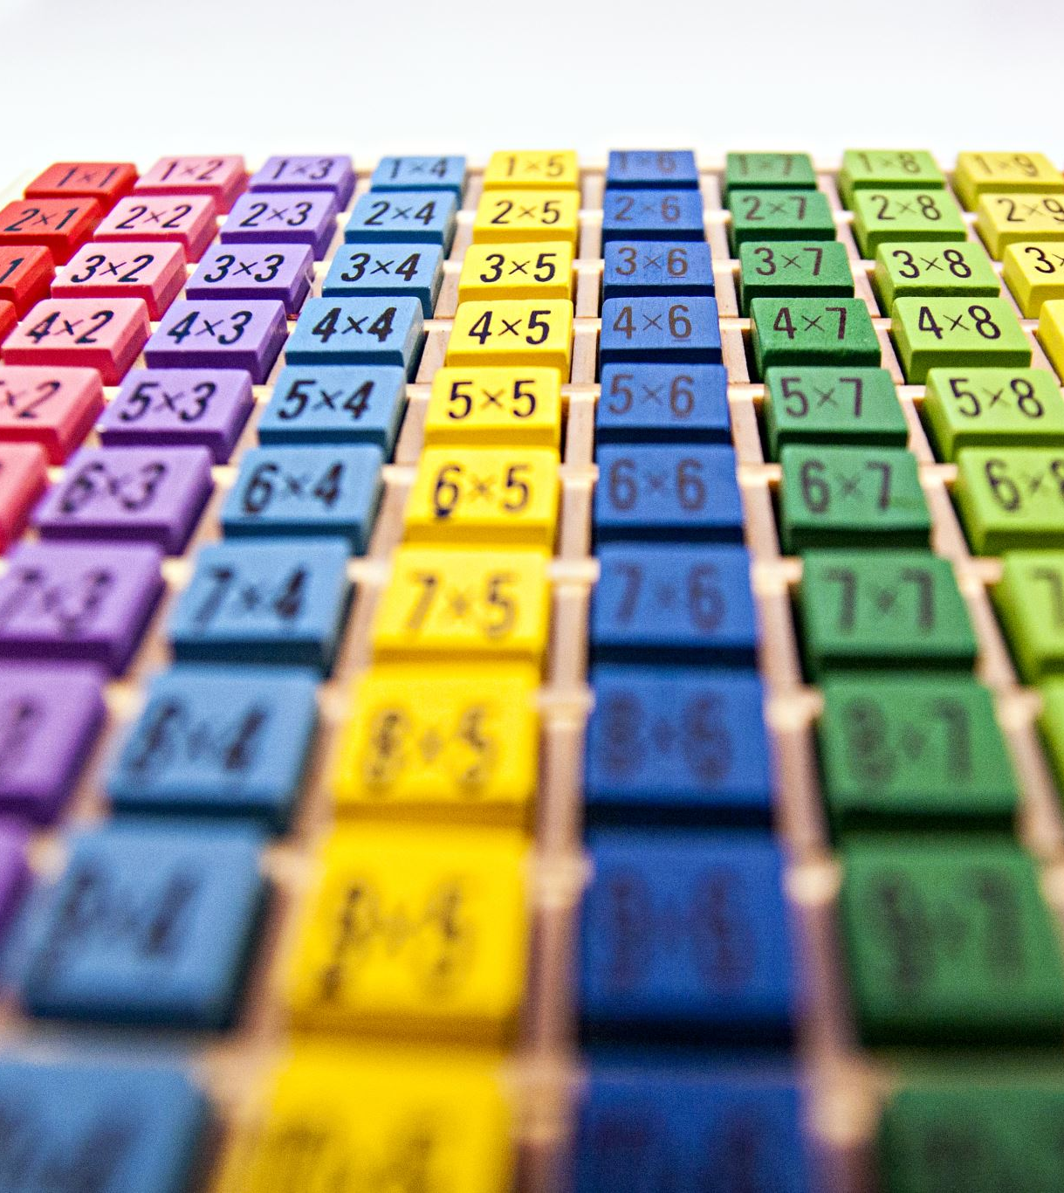
Backbone Network
Convolutional Layers: ~30-50 layers
Batch Normalization Layers: ~30-50 layers (usually one after each convolutional layer)
Residual Blocks: ~10-20 blocks (each containing multiple convolutional and normalization layers)
Downsampling Layers: ~5-10 layers

Slide 20
Metrics
Mean Average Precision (mAP) measures the overall accuracy of object detection or retrieval models, considering both precision and recall.
IoU (Intersection over Union) measures how well a predicted region matches the actual region by calculating their overlapping area.
Mean Average Recall (mAR) measures a model's capability to capture relevant items, emphasizing recall over precision.
F1 Score: The harmonic mean of precision and recall, providing a single metric that balances both. It is particularly useful when you need a balance between precision and recall.

Slide 21
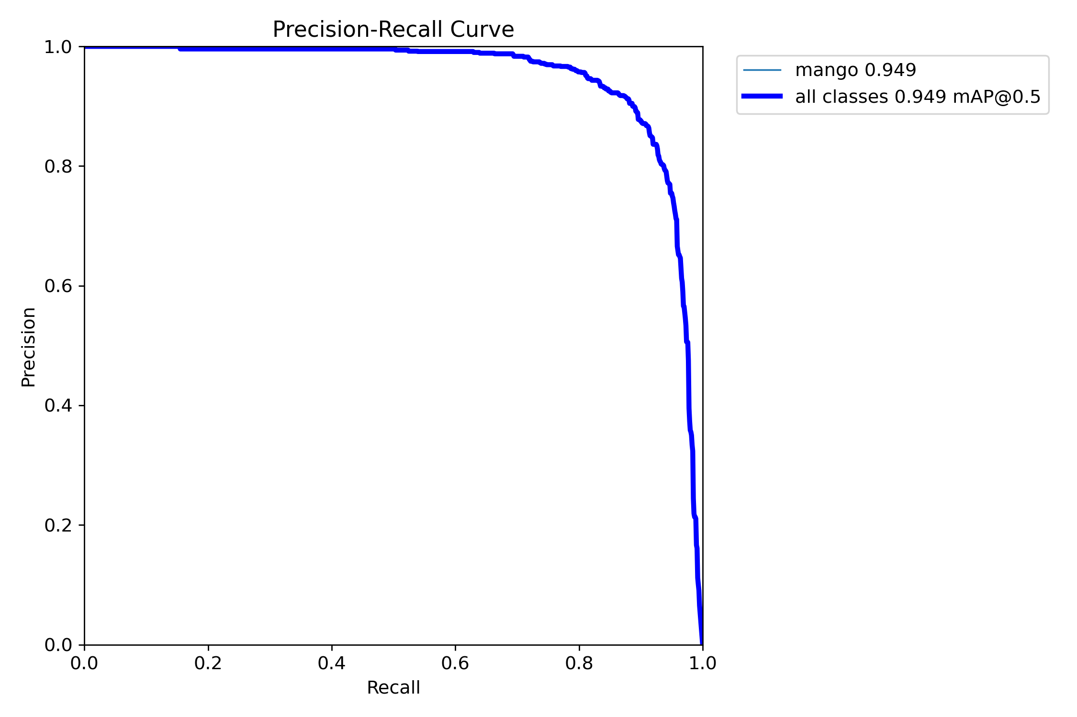
Sydney Dataset
Best model Precision-Recall Curve

Slide 22
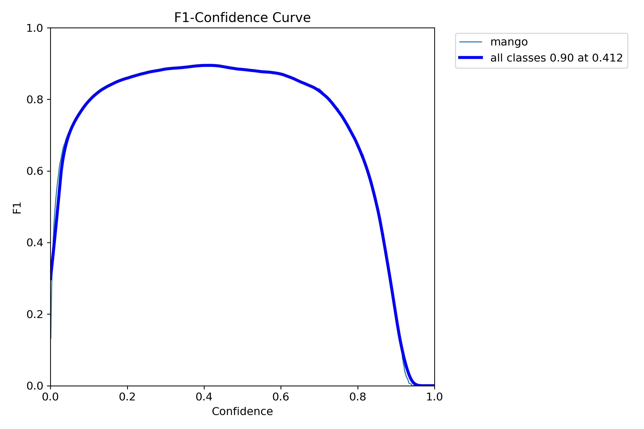
Best Model f1curve

Slide 23
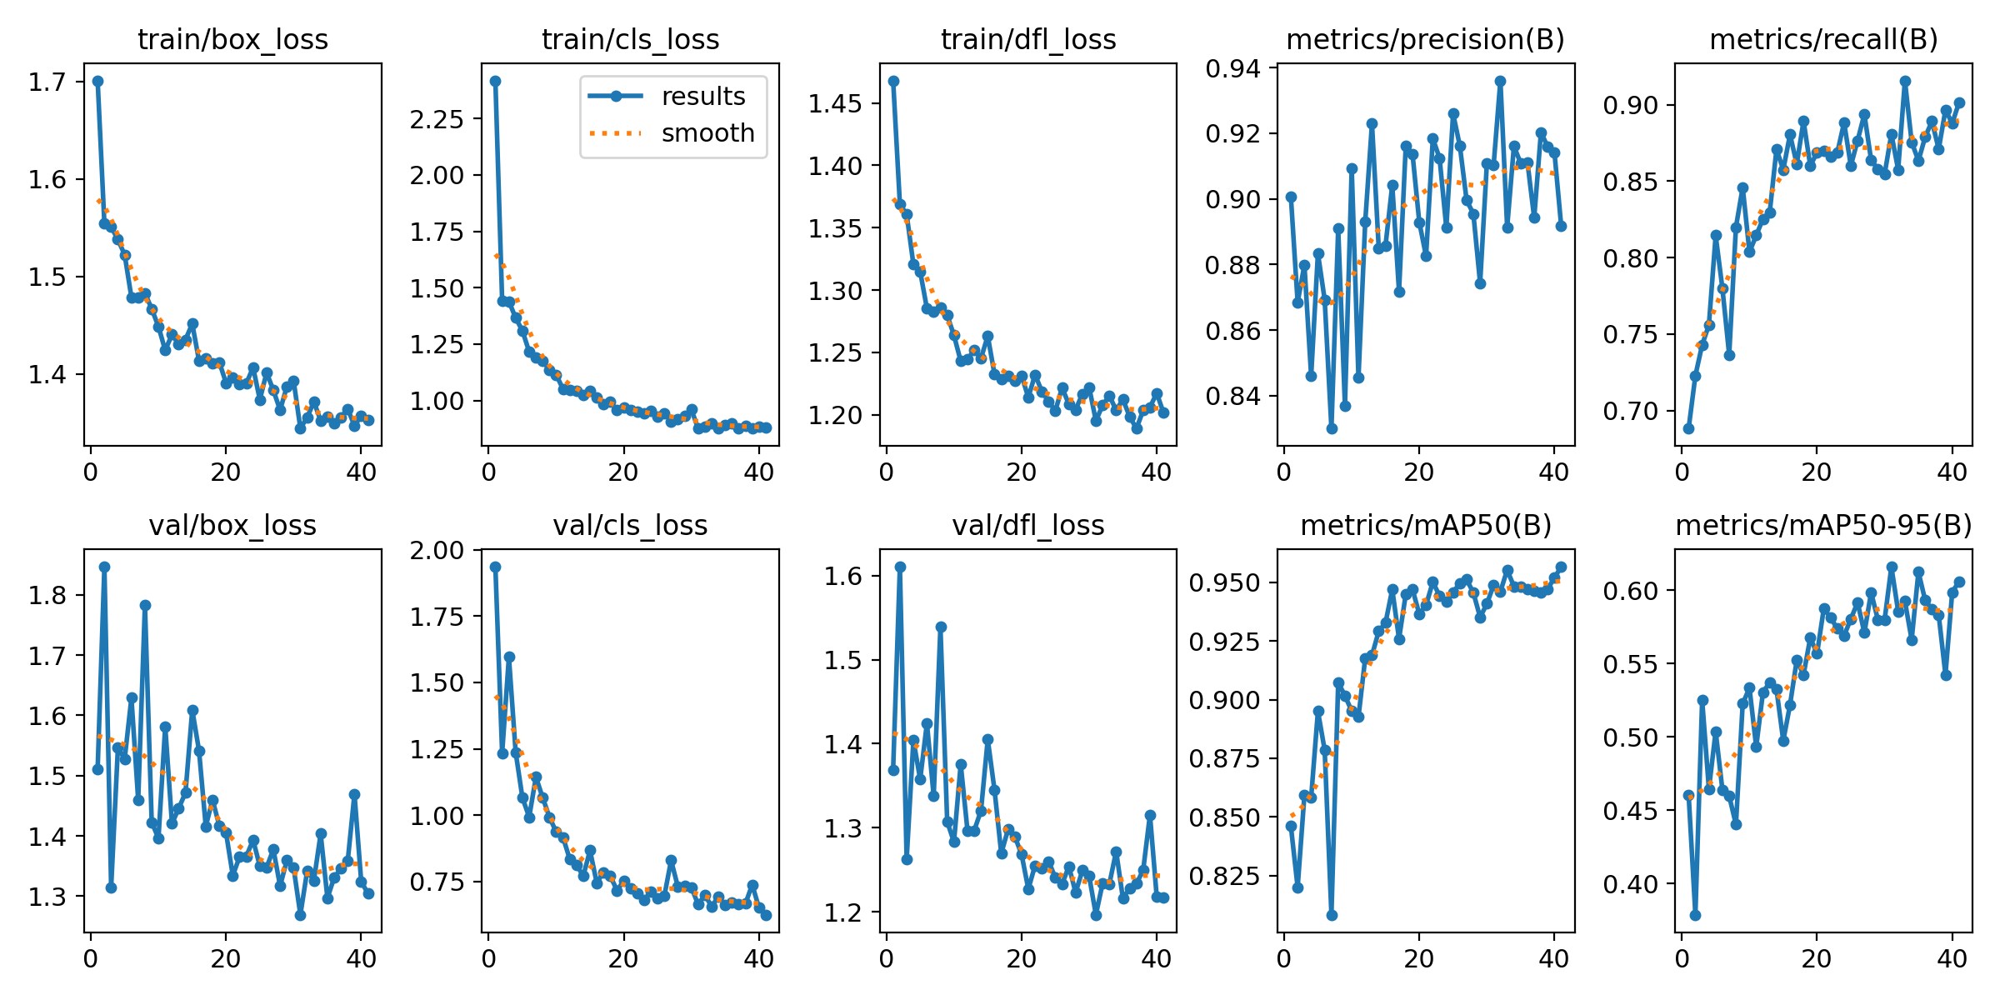
Best model precision, recall, loss results curves

Slide 24
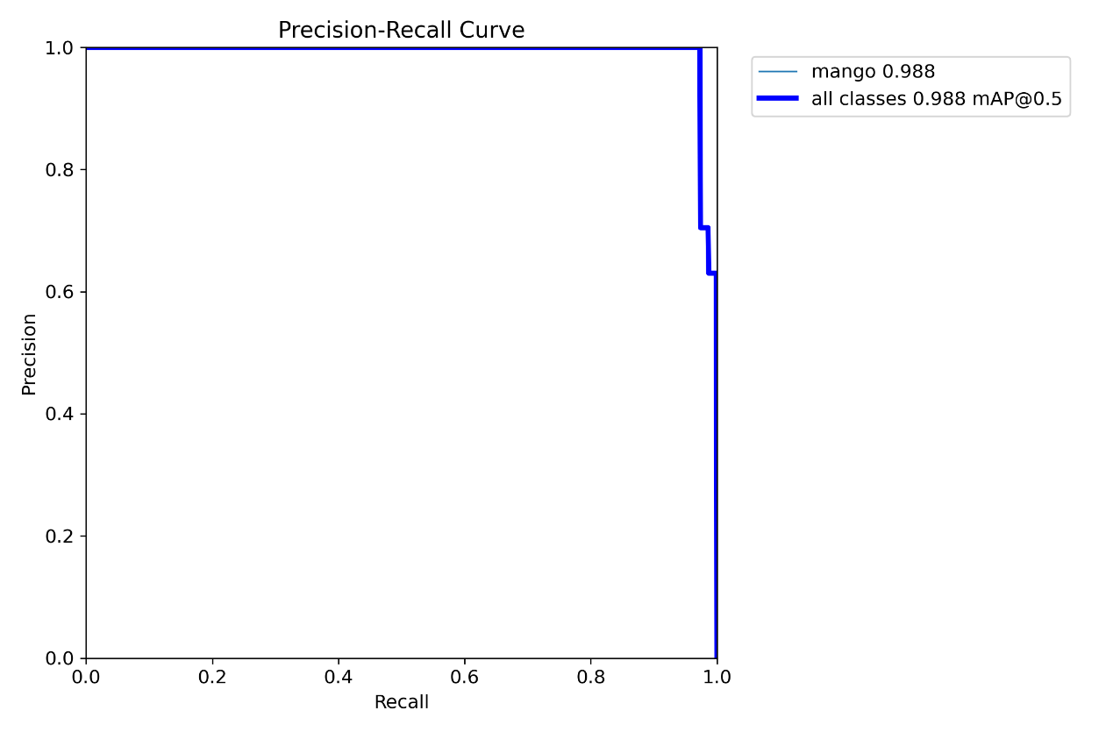
CQUniversity Dataset:
Best model Precision-Recall Curve

Slide 25
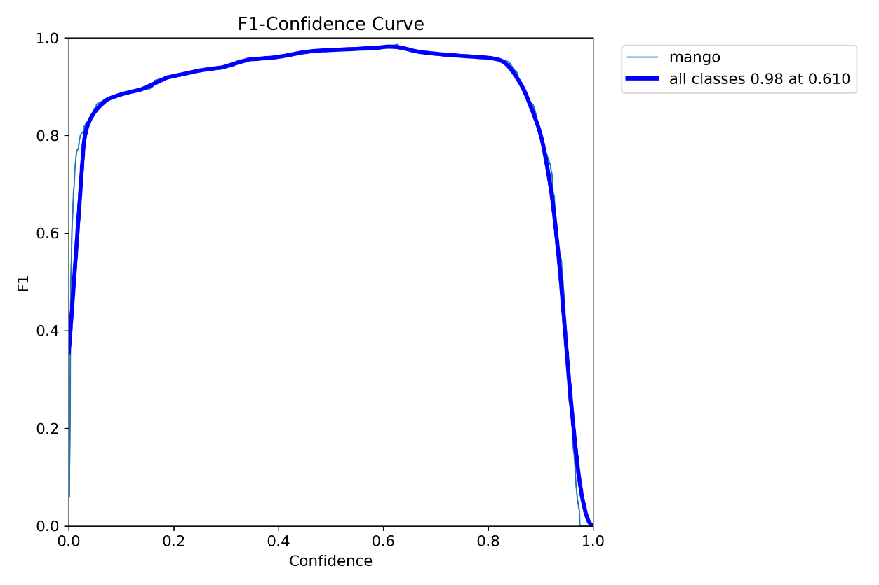
Best Model f1curve

Slide 26
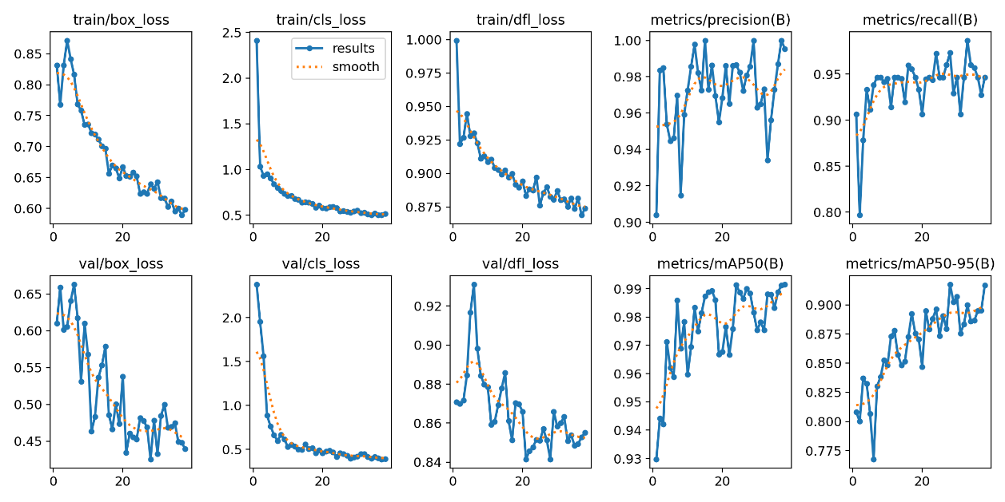
Best model precision, recall, loss results curves
Notes:
0.59821 0.99528 0.94667 0.99149

Slide 27
Training Condition | F1 Score (Confidence) | Precision-Recall (mAP@0.5)
Default Model (50 Epochs) | 0.98 (0.753) | 0.983
Extended Training (100 Epochs) | 0.98 (0.675) | 0.990
Early Stopping without Augmentation | 0.98 (0.753) | 0.983
Early Stopping and Augmentation | 0.98 (0.610) | 0.988
Early Stopping with SGD and Augmentation | 0.99 (0.479) | 0.992
Early Stopping with SGD (No Augmentation) | 0.98 (0.753) | 0.983

Slide 28
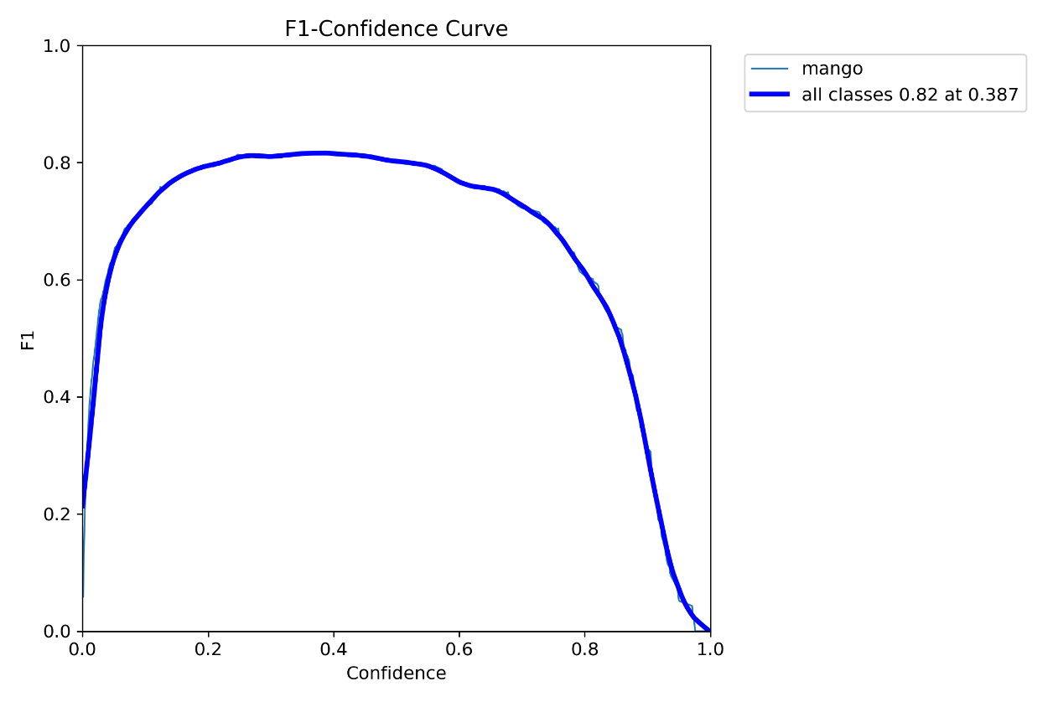
Local Dataset:

Slide 29
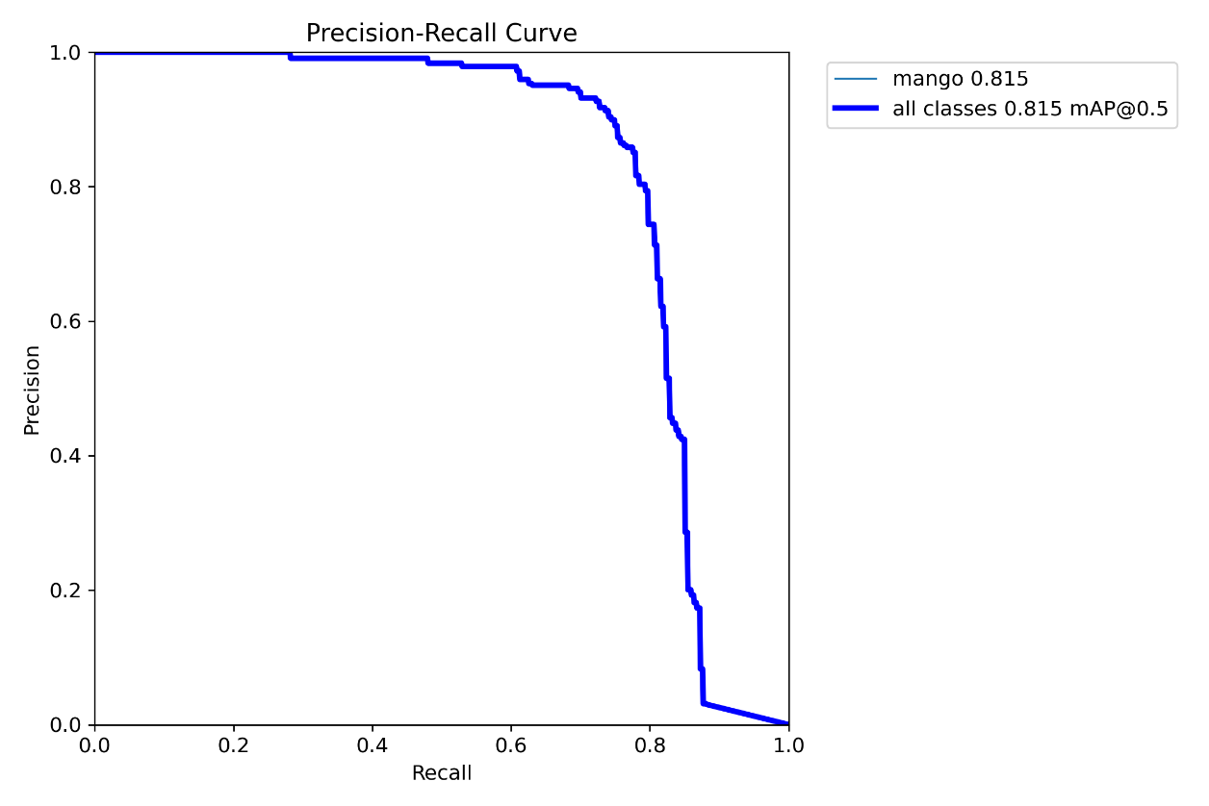
Best model Precision-Recall Curve

Slide 30
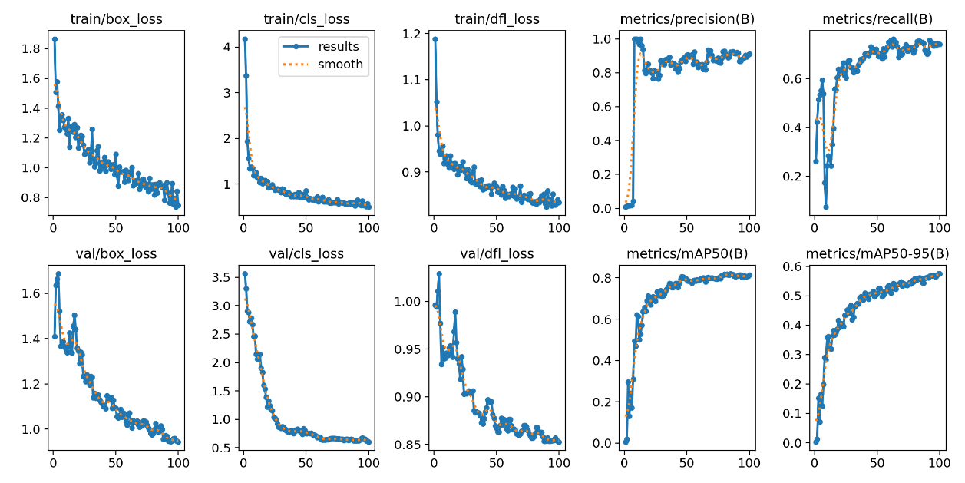
Best model precision, recall, loss results curves
Notes:
0.74957 0.91123 0.74009 0.81486

Slide 31
Training Condition | F1 Score | Precision-Recall (mAP@0.5)
Default Model (50 Epochs) | 0.79 | 0.802
Extended Training (100 Epochs) | 0.82 | 0.815
Early Stopping without Augmentation | 0.80 | 0.792
Early Stopping and Augmentation | 0.80 | 0.809
Early Stopping with SGD and Augmentation | 0.80 | 0.804
Early Stopping with SGD (No Augmentation) | 0.78 | 0.784

Slide 32
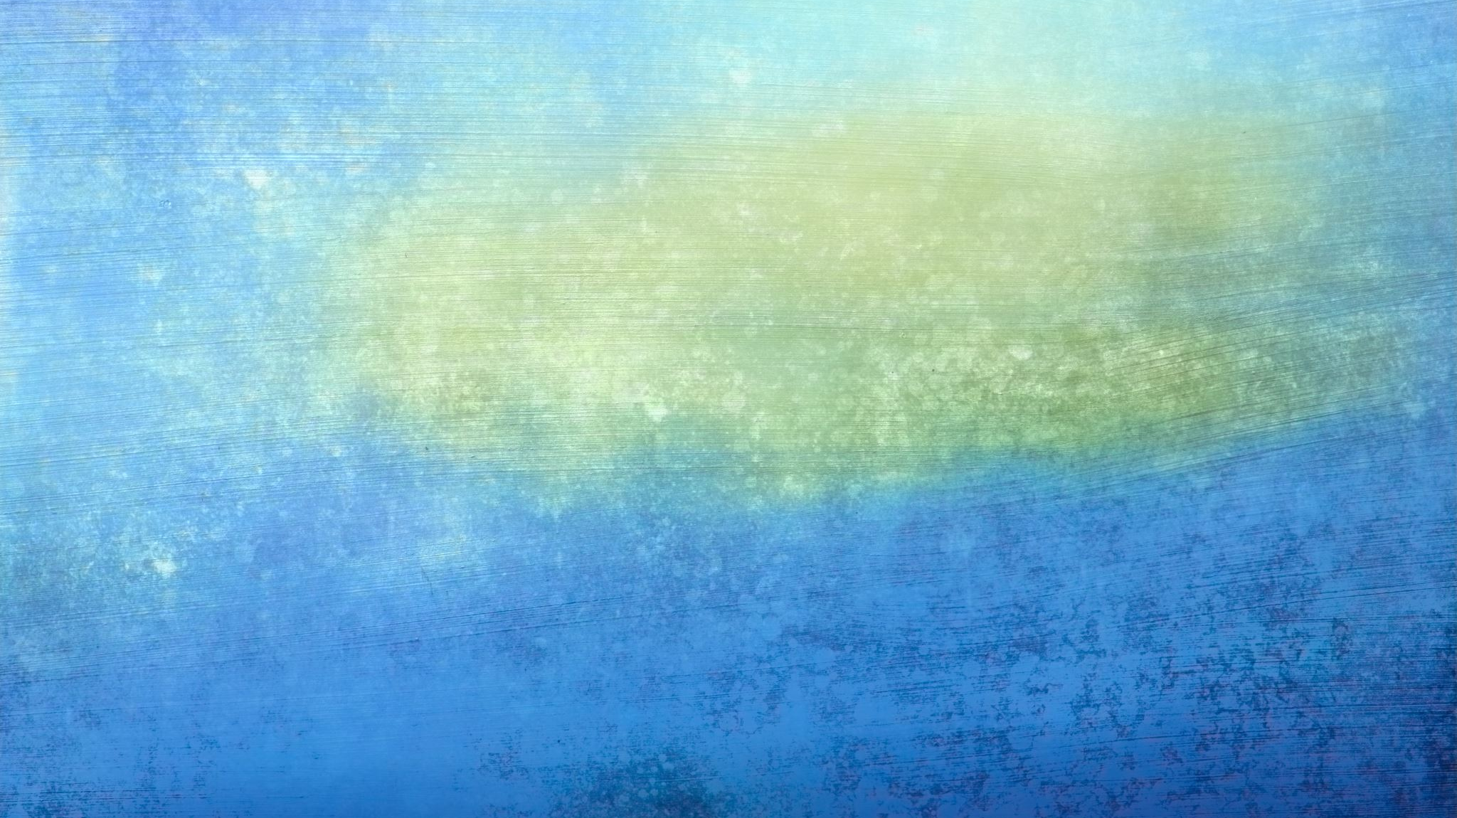
Faster RCNN
For Model 1: Average Precision (AP) is 0.572. Average Recall (AR) is 0.646.
For Model 2: Average Precision (AP) is 0.654. Average Recall (AR) is 0.705.
“Average Precision (AP) @[ IoU=0.20:1.00 | area= all | maxDets=100 ] = 0.654”
Model 2 outperforms Model 1 in both mAP and mAR across all IoU thresholds (from 0.20 to 1.00) and for all detection sizes (maxDets=100). It is more accurate and has a better detection rate.
Notes:
F1_score = 2 * (AP * AR) / (AP + AR)
0.607 0.679 Mean Average Precision (mAP): This plot shows how the average precision of your model's predictions changes over the epochs. The mAP starts low but shows significant improvement, indicating that the model is learning and improving its ability to accurately predict objects.
Mean Average Recall (mAR): The mAR plot indicates how well the model is detecting all relevant objects. Like mAP, mAR starts lower and then rises, showing the model is becoming better at detecting a higher proportion of the relevant objects.
Training Loss: This plot depicts the model's training loss over each epoch. The descending trend of the curve is a good sign, showing that your model is effectively learning and minimizing the loss function over time.
When comparing the performance metrics between Model 1 and Model 2, we can observe that Model 2 outperforms Model 1 in both average precision (AP) and average recall (AR) over all intersection over union (IoU) thresholds from 0.20 to 1.00 and for all detection sizes (maxDets=100).
The higher AP and AR values in Model 2 indicate that it is better at identifying and classifying objects correctly across all categories. The AP is higher, suggesting that the model has a higher precision across different IoU thresholds. The AR is also higher, which indicates that Model 2 is better at finding all the positive samples.
For Model 1: Average Precision (AP) is 0.542. Average Recall (AR) is 0.623.
higher learning rate: Average Precision (AP) @[ IoU=0.20:1.00 | area= all | maxDets=100 ] = 0.572
Average Recall (AR) @[ IoU=0.20:1.00 | area= all | maxDets=100 ] = 0.646
more epochs for new model: Average Precision (AP) @[ IoU=0.20:1.00 | area= all | maxDets=100 ] = 0.656
Average Recall (AR) @[ IoU=0.20:1.00 | area= all | maxDets=100 ] = 0.711

Slide 33
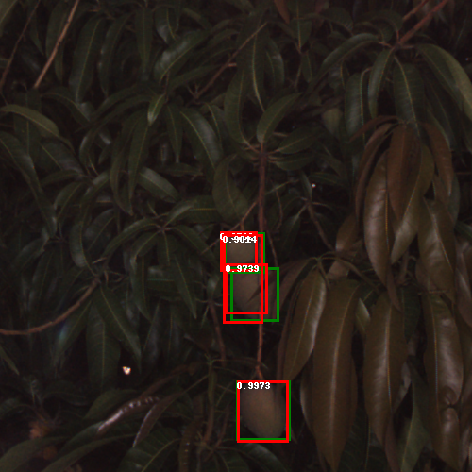
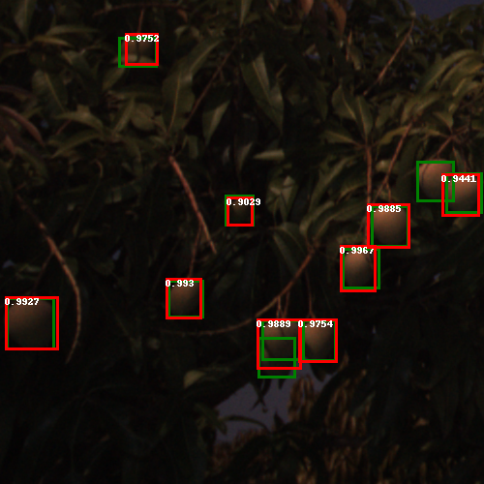
VVG16 test image

Slide 34
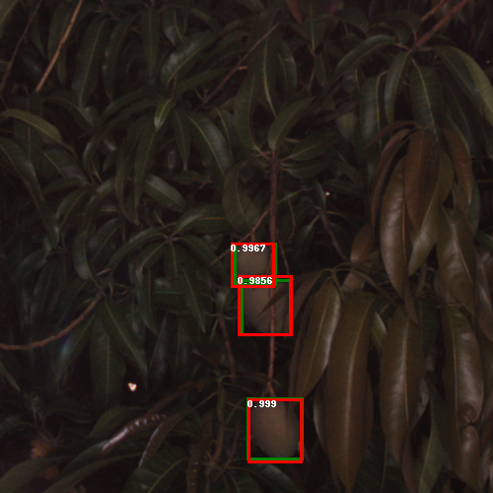

ResNet50 test image

Slide 35
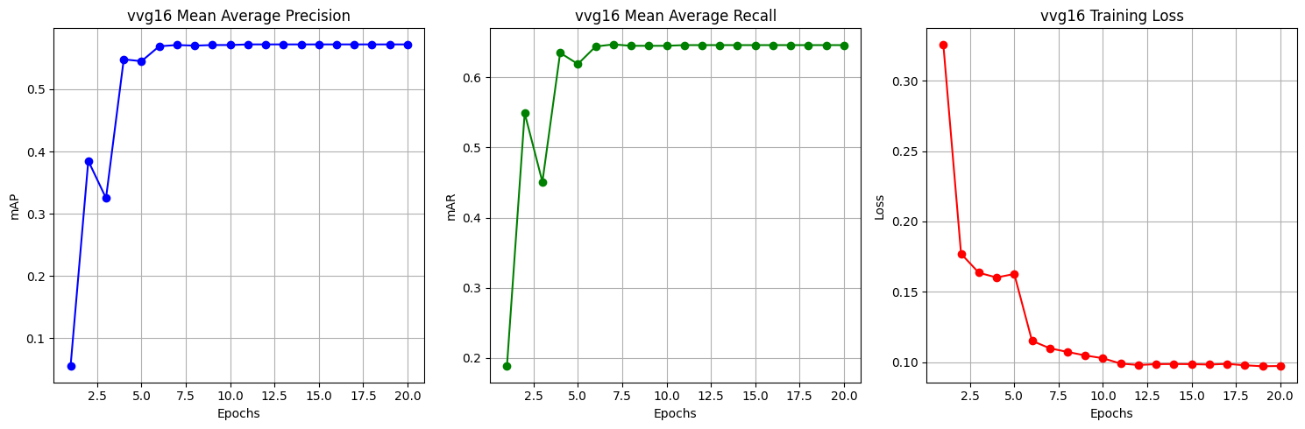
VVG16
Notes:
In the VGG16 model:
The mAP stabilizes around epoch 5 and remains fairly constant from epoch 8 onwards.
The mAR also stabilizes close to epoch 5 and shows very minor fluctuations but is generally flat from epoch 8 onwards.
The training loss drops sharply until about epoch 3 and then gradually flattens, showing very little change past epoch 8.
map_values = [ 0.055, 0.385, 0.325, 0.548, 0.545, 0.569, 0.571, 0.570, 0.571, 0.571, 0.572 ]
mar_values = [ 0.188, 0.549, 0.451, 0.635, 0.619, 0.644, 0.647, 0.645, 0.645, 0.645, 0.646 ]
training_loss = [ 0.3258, 0.1770, 0.1635, 0.1601, 0.1626, 0.1151, 0.1098, 0.1072, 0.1047, 0.1027,
0.0989, 0.0979, 0.0985, 0.0986, 0.0985, 0.0982, 0.0987, 0.0977, 0.0970, 0.0972 ] Mean Average Precision (mAP): This plot shows how the average precision of your model's predictions changes over the epochs. The mAP starts low but shows significant improvement, indicating that the model is learning and improving its ability to accurately predict objects.
Mean Average Recall (mAR): The mAR plot indicates how well the model is detecting all relevant objects. Like mAP, mAR starts lower and then rises, showing the model is becoming better at detecting a higher proportion of the relevant objects.
Training Loss: This plot depicts the model's training loss over each epoch. The descending trend of the curve is a good sign, showing that your model is effectively learning and minimizing the loss function over time.

Slide 36
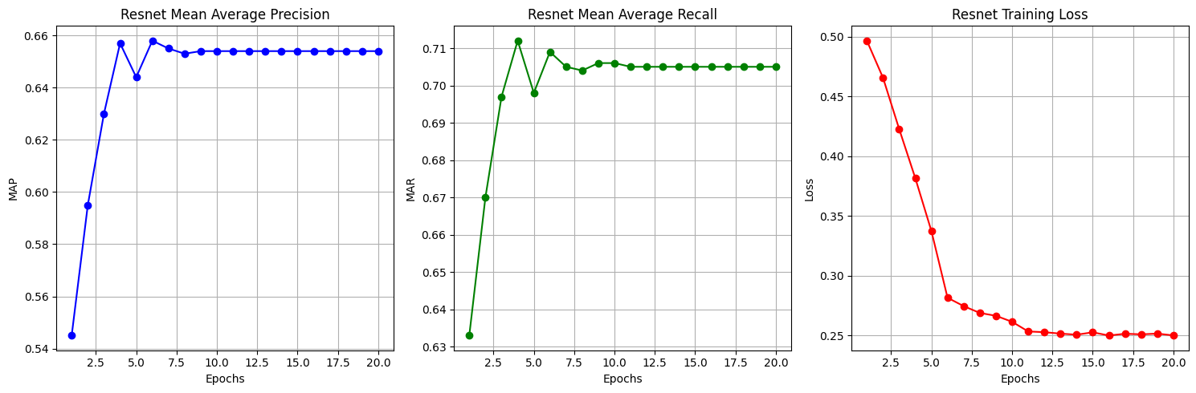
ResNet
Notes:
For the ResNet model:
The mAP increases sharply until about epoch 4 and then plateaus, with little to no improvement after epoch 8.
The mAR shows improvement until around epoch 5 and then enters a plateau with some minor fluctuations but no significant upward trend after epoch 8.
The training loss exhibits a sharp decrease until approximately epoch 3, then a much slower rate of decrease, and becomes relatively flat after epoch 8.
map_values = [0.545, 0.595, 0.630, 0.657, 0.644, 0.658, 0.655, 0.653, 0.654, 0.654, 0.654]
mar_values = [0.633, 0.670, 0.697, 0.712, 0.698, 0.709, 0.705, 0.704, 0.706, 0.706, 0.705]
training_loss = [0.4967, 0.4657, 0.4229, 0.3818, 0.3375, 0.2817, 0.2747, 0.2690, 0.2666, 0.2616,
0.2535, 0.2529, 0.2517, 0.2508, 0.2528, 0.2501, 0.2516, 0.2511, 0.2517, 0.2502]
Mean Average Precision (MAP): The first plot shows the MAP values across epochs. It starts at 0.545 and gradually increases, reaching a plateau around 0.654.
Mean Average Recall (MAR): The second plot represents the MAR values. These values also increase over time, starting from 0.633 and stabilizing around 0.706.
Training Loss: The third plot illustrates the training loss. It starts at 0.4967 and consistently decreases over epochs, indicating that the model is learning and improving its performance. The loss value stabilizes around 0.2502 towards the later epochs.

Slide 37
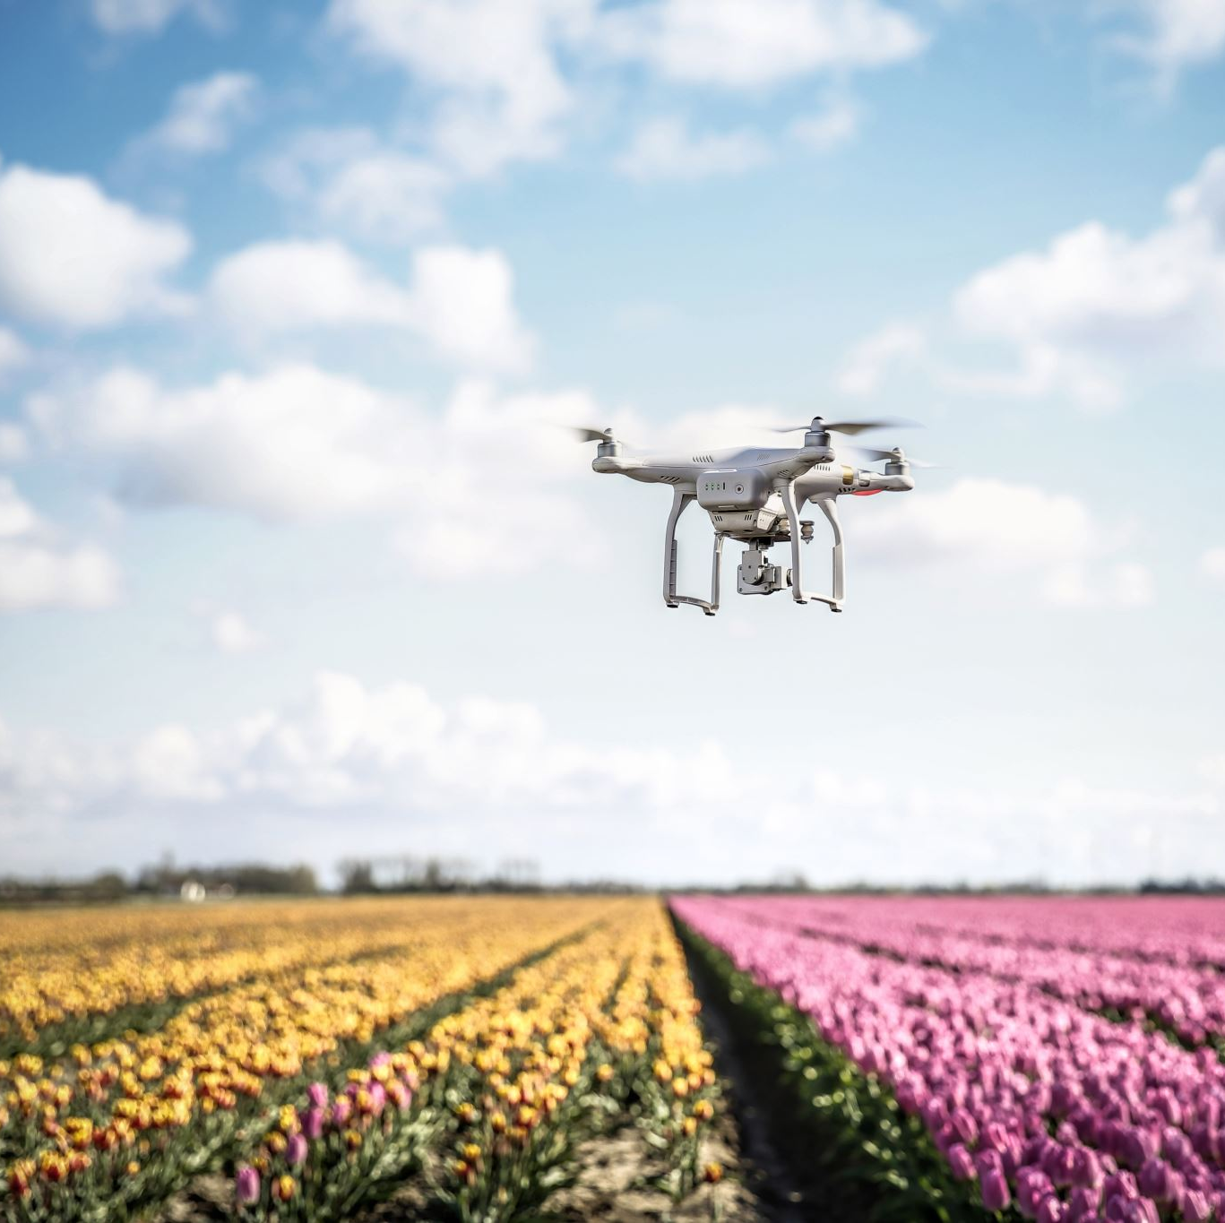
Project Budget
Drone for Aerial Imaging:
Faculty-supplied for orchard image capture
Model Development Platform:
Using my device GPU for model development.
Additional Costs:
No anticipated extra expenses for project completion.

Slide 38
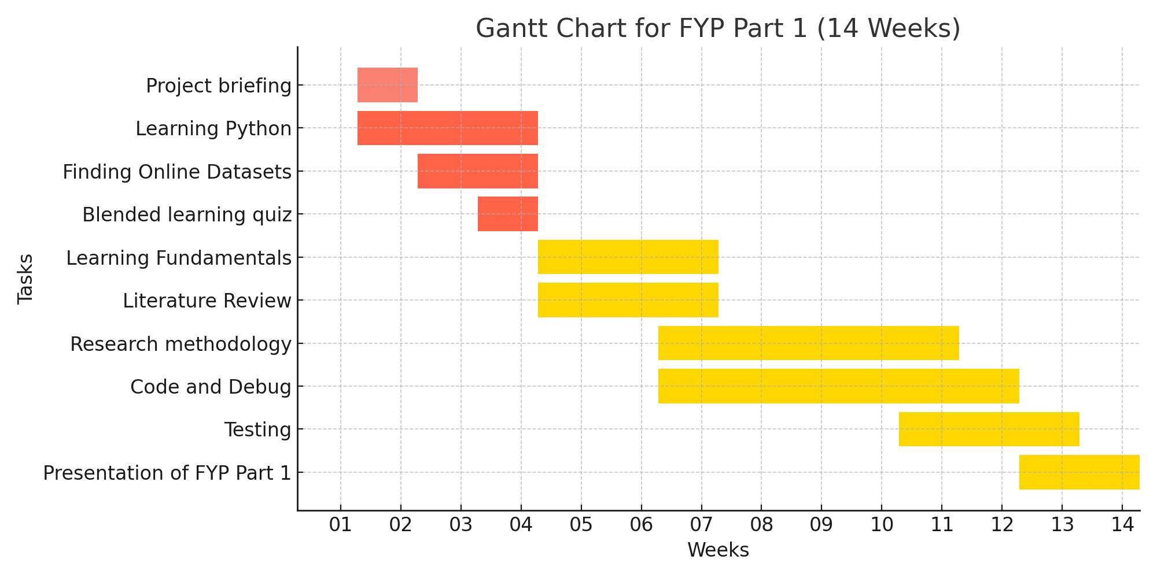
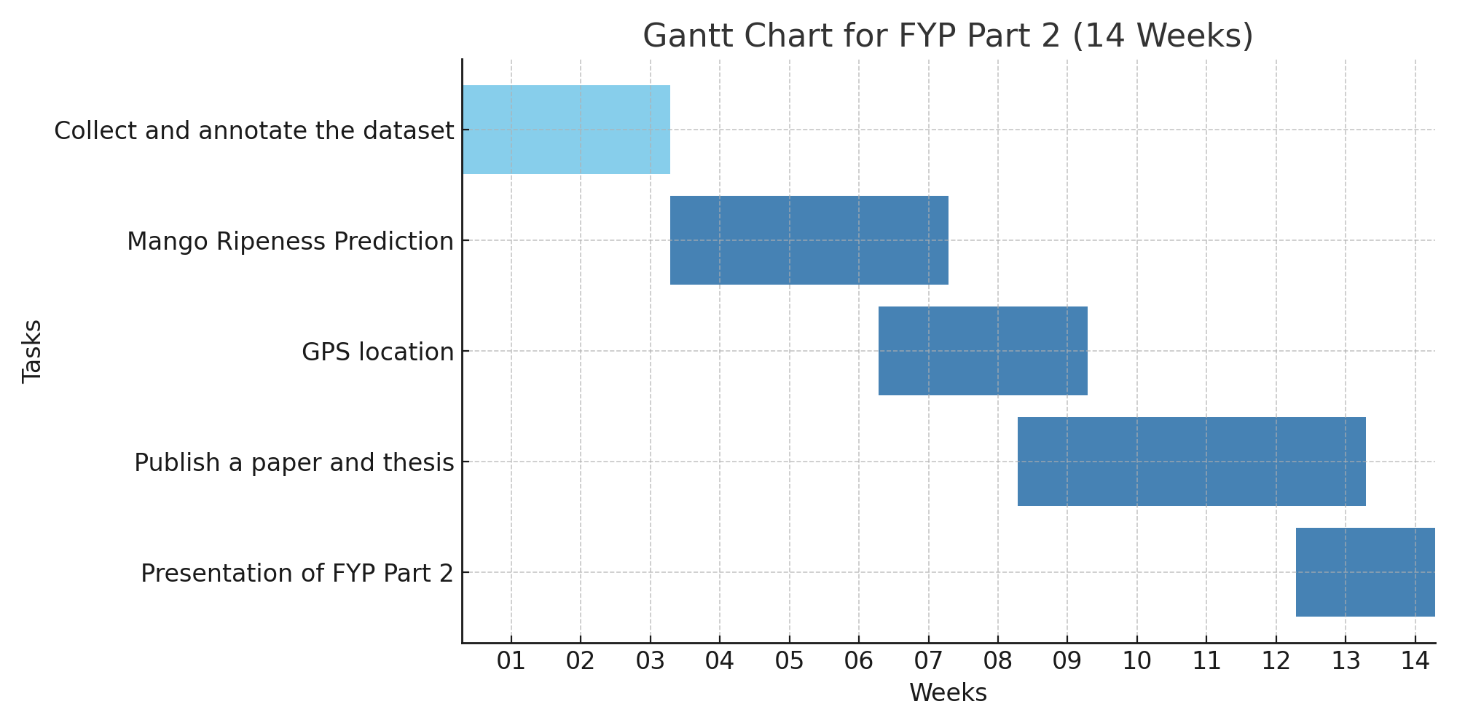
Project Timeline
Notes:
Chatgpt Reference

Slide 39
Project (part 2 ) –Future Plans
Predict mango ripeness status

Slide 40
Thank you
Any questions?

Slide 41
References:
https://numpy.org/
https://matplotlib.org/
https://pandas.pydata.org/
https://colab.google/
https://pytorch.org/
https://pytorch.org/vision/main/models/faster_rcnn.html
S. &. U. Bargoti, "Deep fruit detection in orchards," IEEE International Conference on Robotics and Automation (ICRA), pp. pp. 3626-3633, 2017.

Slide 42
References
Zhen Liu, Shumian Chen, Bolin Liu, Zhenhui Zheng, Zhuo Zhong, Zhengang Yang, Hongxing Peng, "Visual detection of green mangoes by an unmanned aerial vehicle in orchards based on a deep learning method," Biosystems Engineering, vol. 194, no. 1537-5110, pp. 261-272, 2020.
A. R. a. R. Machavaram, "Detection and Localisation of Farm Mangoes using YOLOv5 Deep Learning Technique," pp. 1-5, 2022.
K. J. a. M. A. S. C, "Real Time Riped Fruit Detection using Faster R-CNN Deep Neural Network Models," IEEE International Conference on Smart Technologies and Systems for Next Generation Computing (ICSTSN), pp. 1-4, 2022.
R. Nithya, B. Santhi, R. Manikandan, M. Rahimi and A. Gandomi, "Computer Vision System for Mango Fruit Defect Detection Using Deep Convolutional Neural Network," Foods, vol. 11, 2022.
"The University of Sydney's ACFR Multi-fruit Dataset," [Online]. Available: https://data.acfr.usyd.edu.au/ag/treecrops/2016-multifruit/.

